Slide 1















INDEX
2025
On-Device AI-Based Smart Unmanned Store Integrated Management System
HyunDo Yoon
Sunbin Lee
SangWoo Jeon
HyeChang Hong
Irene Choi
Store
Shield
2071015
2071122
2071094
2071148
2271414

Slide 2





INDEX
PROJECT
2025
Team Member
Participation
Project Topic
Smart unmanned store integrated management system
FUNCTION
Key Features
Security | Sales | Inventory Management
UX/UI Design
with Figma
QUALCOMM
Model
Yolo Nas-Q | Lightweight Face Detection-Q
On device
Project Conformity
Store
Shield
Notes:
팀원 구성 - 팀원 참여도
프로젝트 주제
주요기능
UX/UI 디자인
온디바이스 fit 정도
사용하는 Qualcomm 모델
구현현황 - 개발 진척도
향후계획

Slide 3









팀원소개
Irene
HyeChang | SangWoo
HyunDo | Sunbin
Design / Front-End
AI / APP
Back-End / APP
Mobile App UI/UX Design
Object Recognition & Tracking Algorithms
Server architecture implementation
Implementing a Web Dashboard
Behavioral Analysis Model Design
API development and DB management
Store
Shield
Optimizing User Experience
Abnormal Behavior Detection System
Data Processing and Analysis Systems

Slide 4





Security
Project Topic
Smart Unmanned Store Integrated Management System
Background
Goals
“The unmanned store is growing rapidly due to rising labor costs and increased demand for 24-hour operations."”
"We aim to develop an integrated solution that can efficiently operate the security, inventory management, and store management of unmanned stores by utilizing real-time AI image analysis."
# Increased risk of crime such as theft and vandalism
# Security systems without real-time response
# Operational inefficiency due to passive inventory management
# Real-time customer tracking & ID-based behavioral analysis : Reduce theft risk
# Automatic Inventory System : Prevent shortage & Improve Order Efficiency
# Data-driven store analysis system : Increase sales & customer satisfaction
# Android APP : Remote Integrated Management
Inventory
Sales

Slide 5
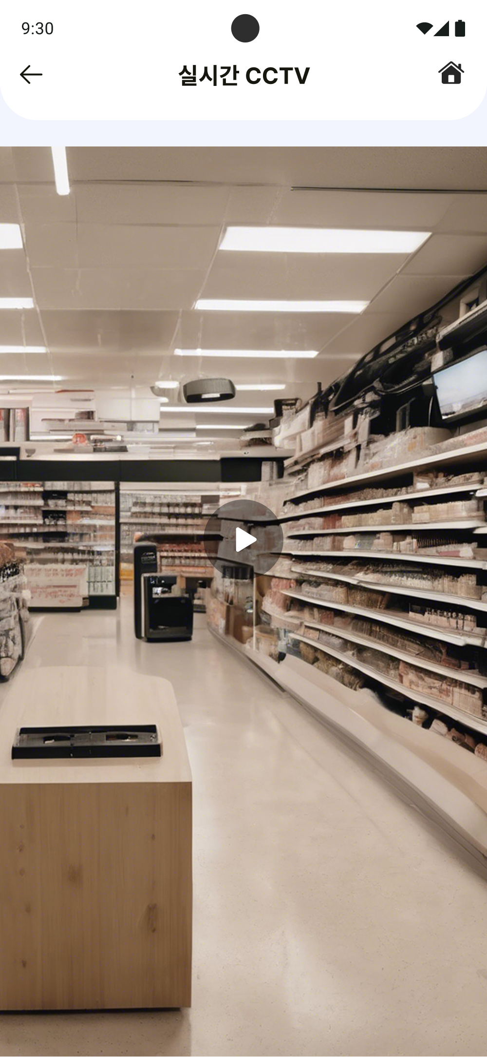

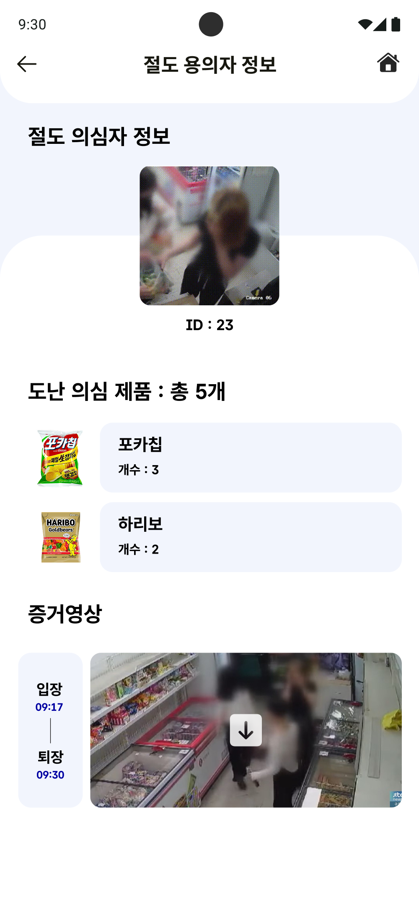

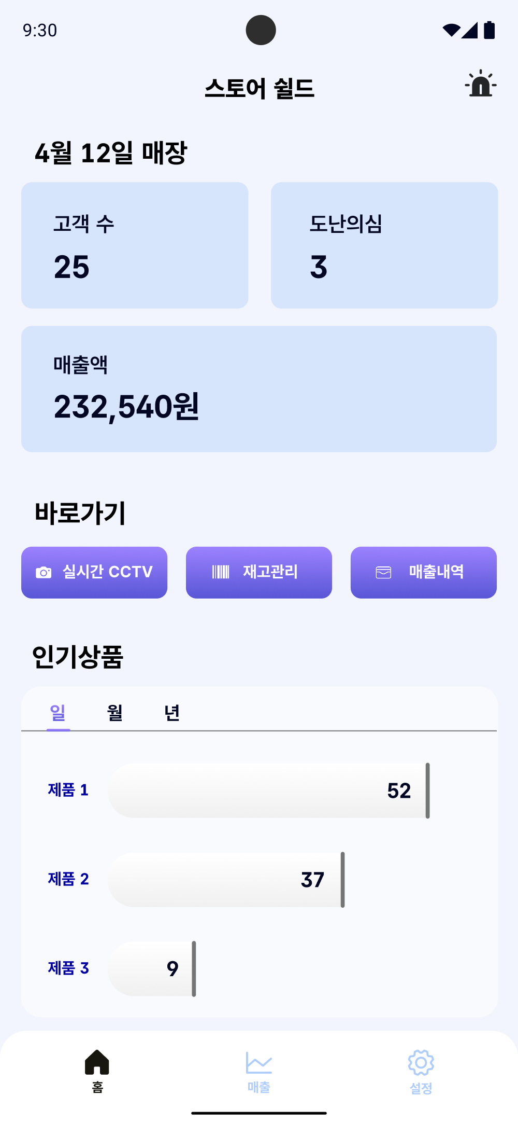
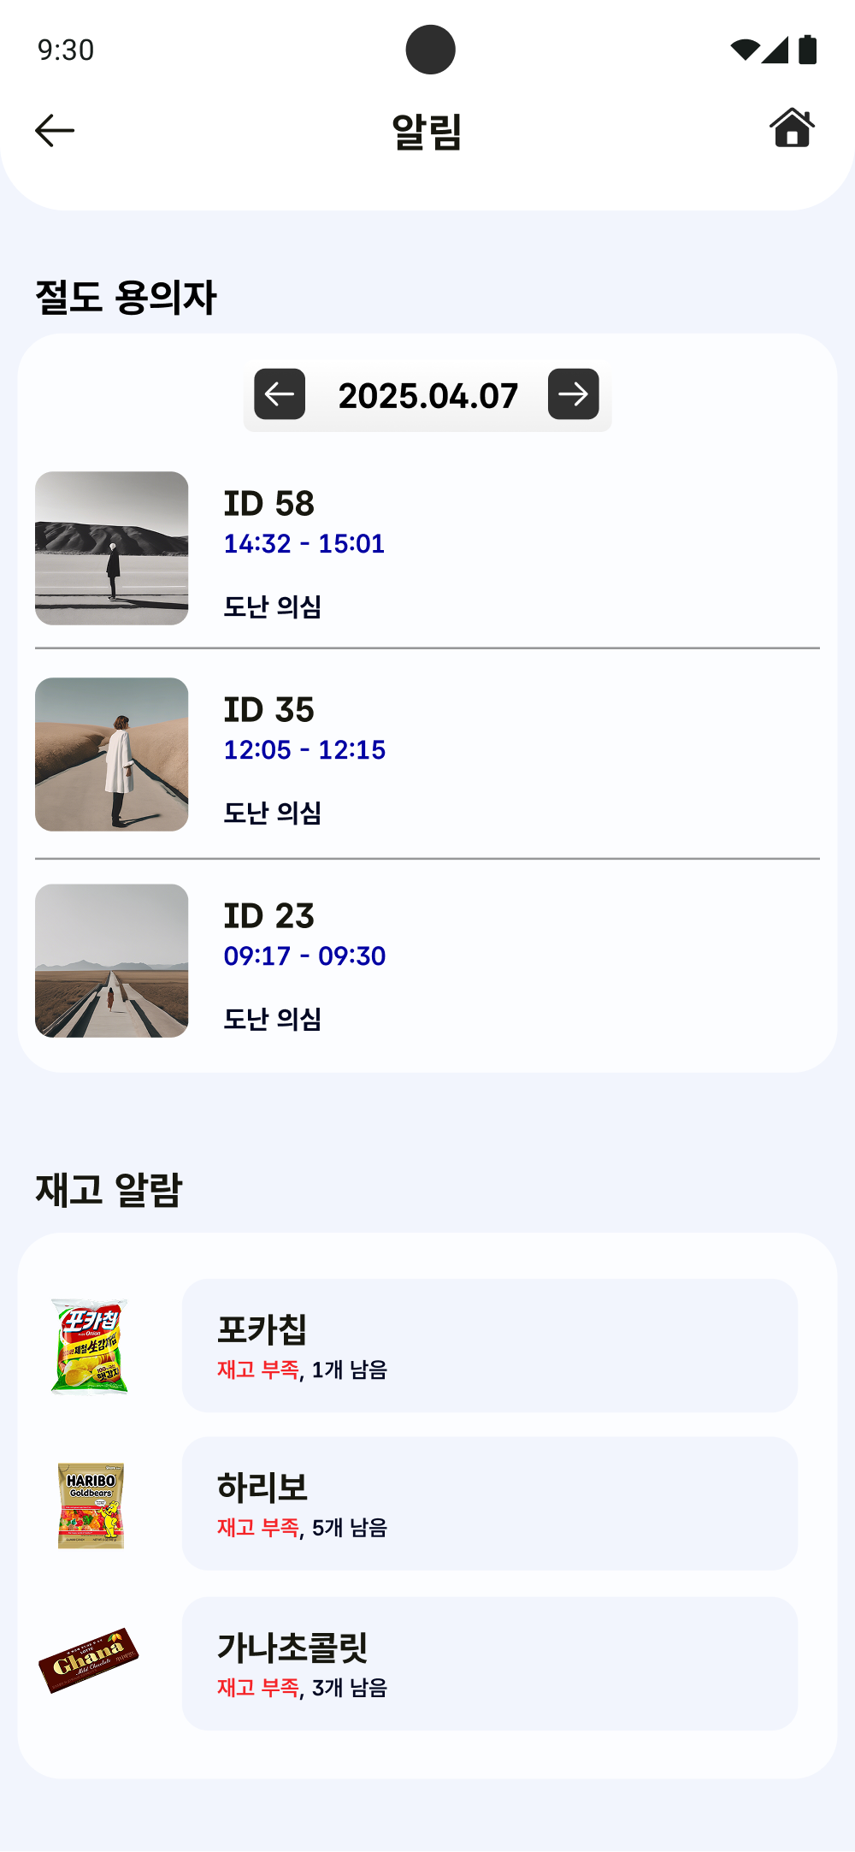
Key Features
The main function of our project is
the Management of “Security”, “Sales” and “Inventory”.
FUNCTION. 1
FUNCTION. 2
FUNCTION. 3
Security
Sales
Inventory
Object tracking and ID assignment when entering real-time
Automatic notification system for exit without payment
Mobile App Integrated Monitoring
Real-time Sales Analysis
Analysis of Popular Products
Real-time inventory monitoring
automatic ordering system
+ automatic payment
Store
Shield

Slide 6

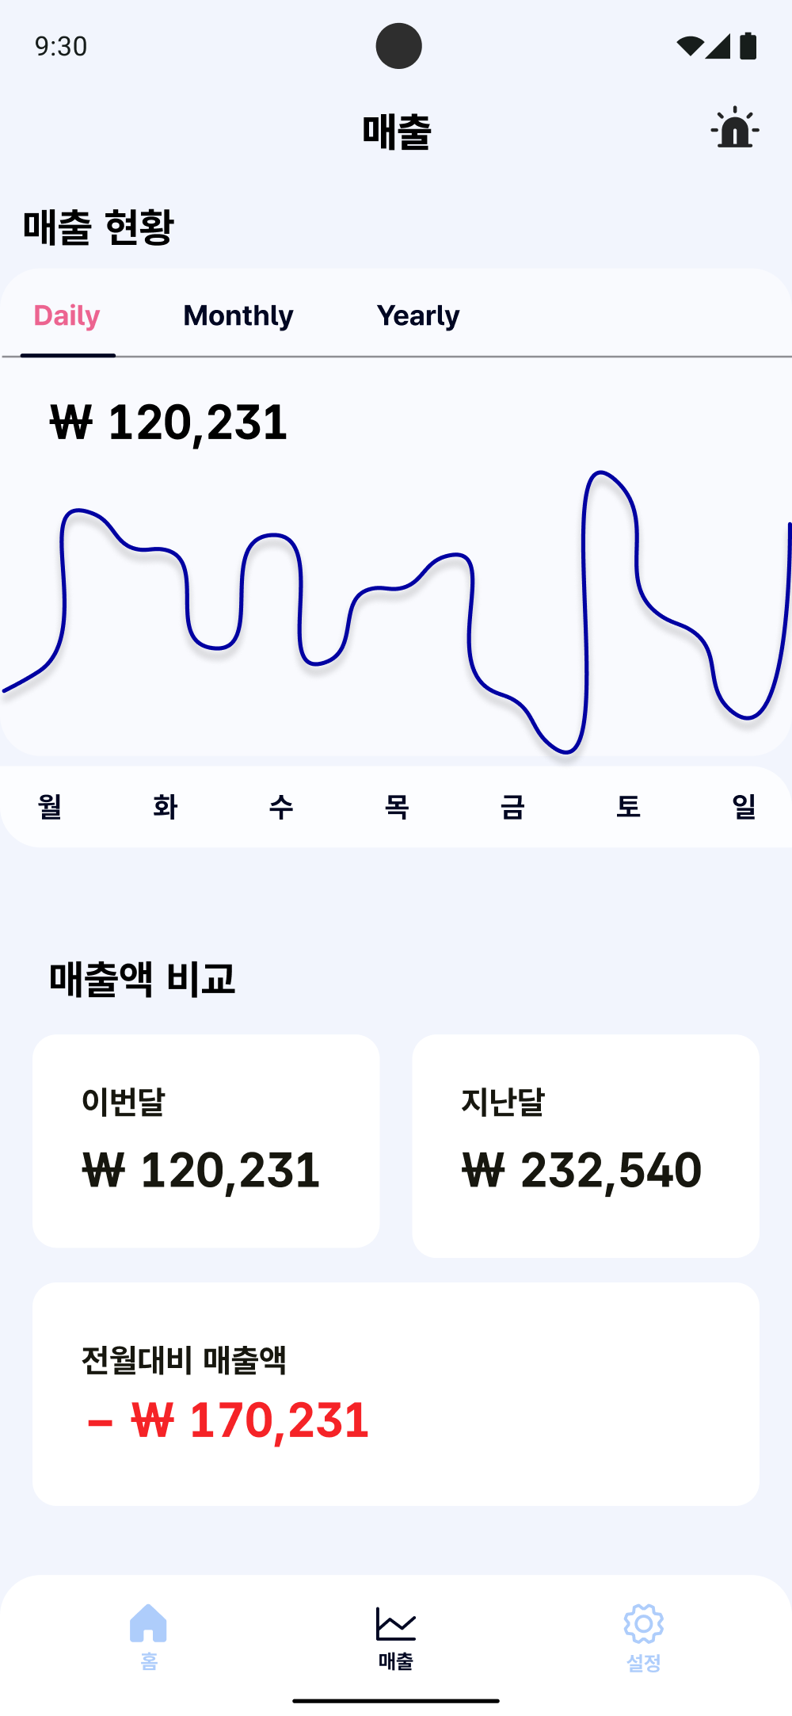
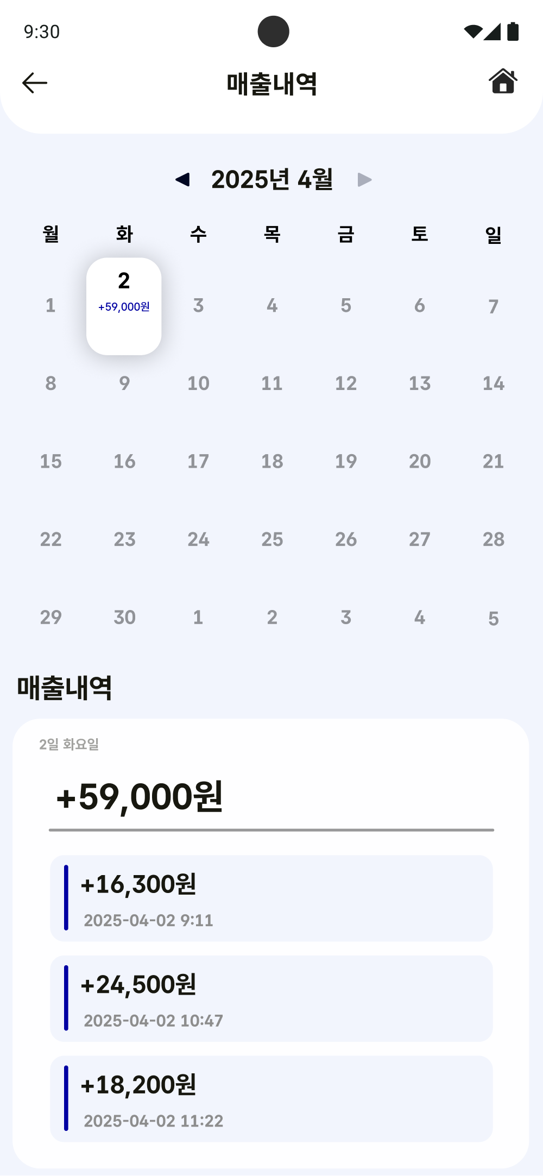
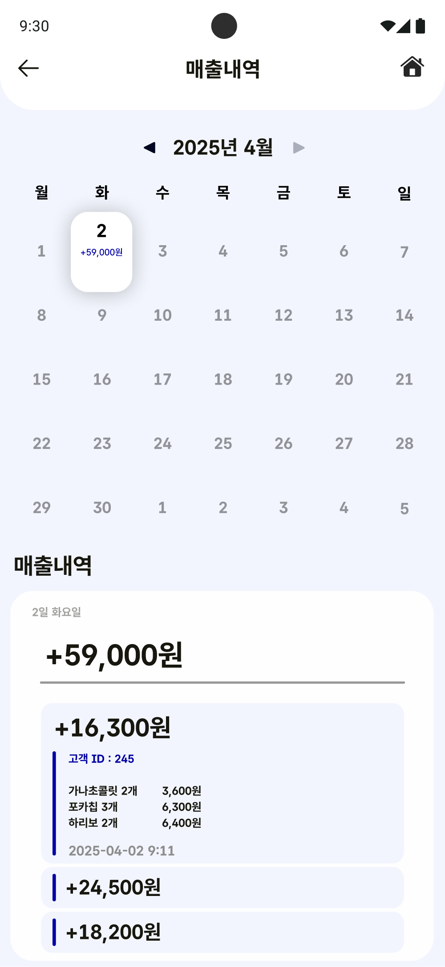
1 | Security Management

Slide 7
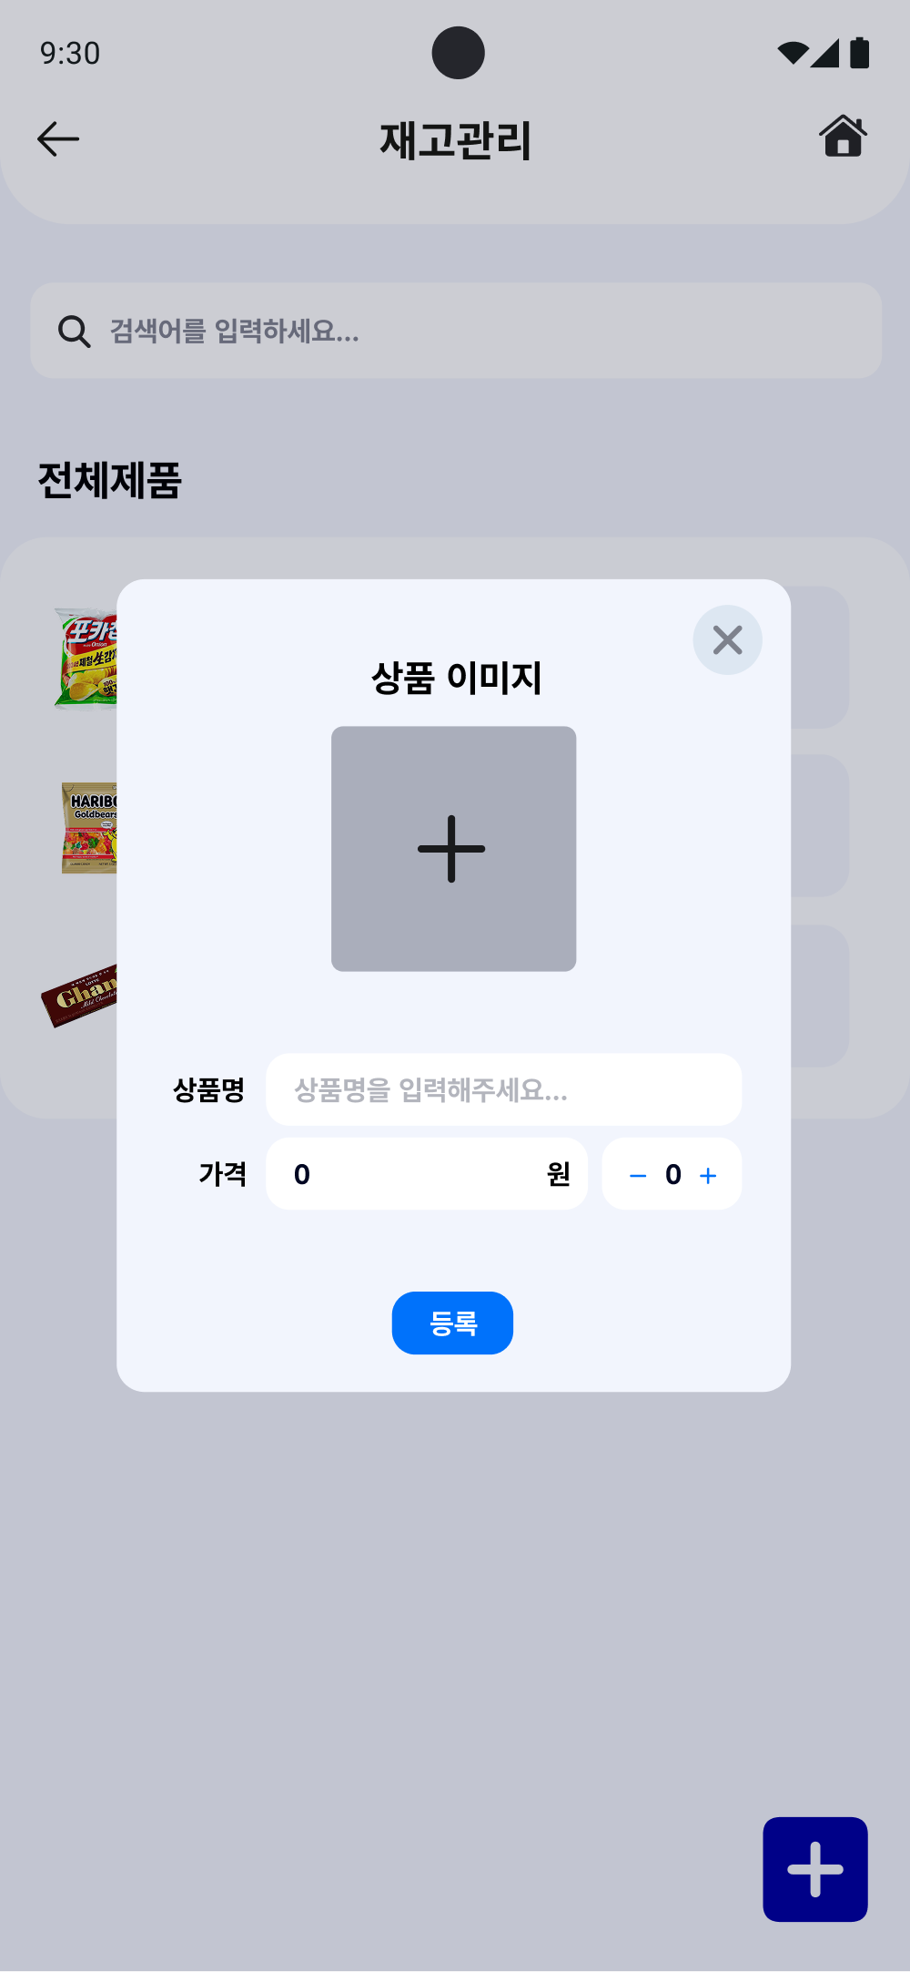
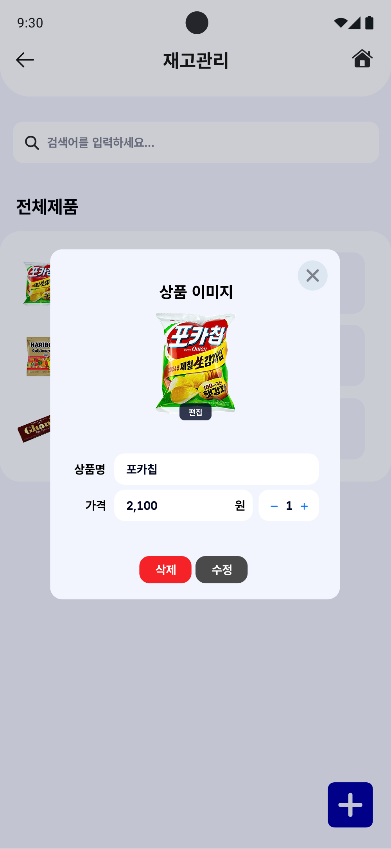
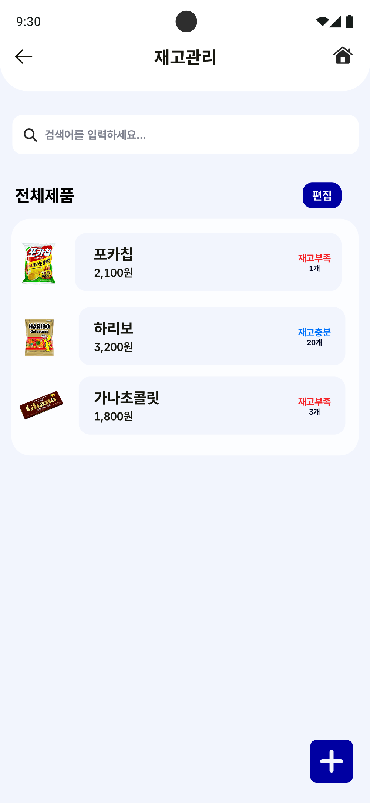
2 | Sales Management

Slide 8
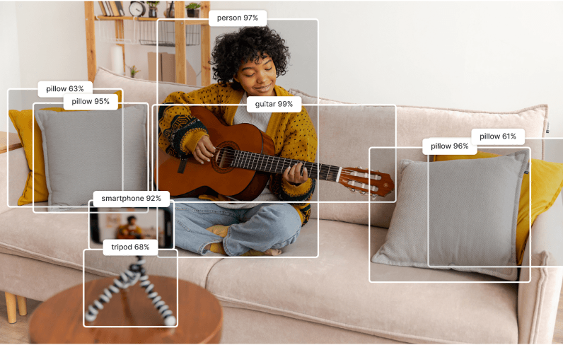

3 | Inventory Management

Slide 9



Qualcomm AI Hub
Now using,
QUALCOMM AI Model
Yolo Nas Quantized
Lightweight Face Detection Quantized
Store
Shield

Slide 10
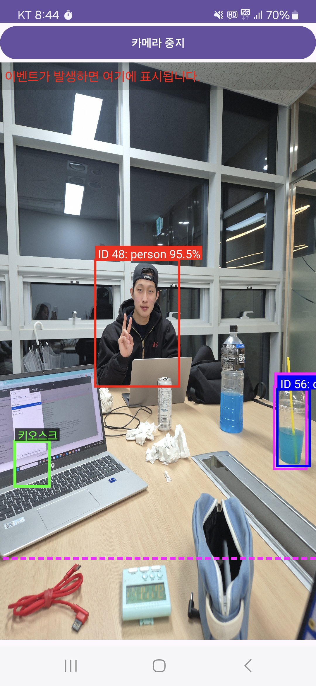
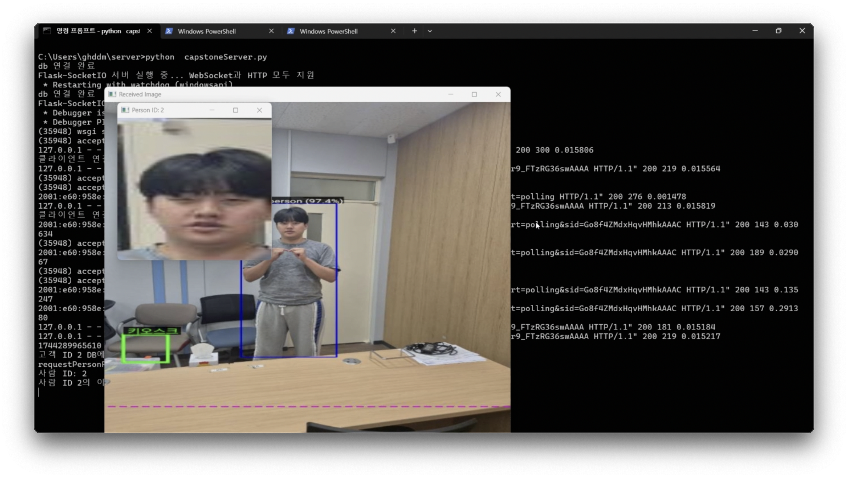
Using, QUALCOMM AI Model
Qualcomm AI Hub
Yolo Nas Quantized
Lightweight Face Detection Quantized

Slide 11
Normal Payment Scenario

Slide 12
Theft Scenario

Slide 13
General Customer Scenario

Slide 14






On-Device AI
Smart Shield
Huge server cost savings
Edge Computing
Reduce dependence on the cloud
Notes:
저희 프로젝트에서 온디바이스를 사용하였을 때의 장점은 막대한 서버비용을 절약할 수 있다는 것입니다.
"많은 가맹점이 존재할 때, 서버에서 영상을 분석하게 되면 엄청난 서버비용이 발생합니다.
또한 네트워크 대역폭 한계, 데이터 전송 지연, 보안 취약성이 증가하며, 서버 장애 시 전체 시스템이 마비되는 위험이 있습니다.
저희는 말단 기기인 CCTV에 온디바이스 AI를 적용하여 엣지 컴퓨팅 기술을 활용합니다.
이를 통해 서버의 부하를 분산시켜 클라우드 의존도를 줄이고, 실시간 처리 성능을 향상시키며 안정적인 운영이 가능한 시스템을 구축했습니다.

Slide 15

On-Device AI
Smart Shield
Portrait Rights
&
Privacy Leakage

Slide 16








SYMPOSIUM
온디바이스 AI 기반 스마트 무인점포 통합관리 시스템
참여사 |
TEAM | 윤현도 이선빈 전상우 홍혜창 최은서

